Slide 1

Brenda’s Glass Expression
Website Proposal
Josmi Jose DGL 103 CVS1

Slide 2

The Client : Brenda’s Glass Expression
Brenda's Glass Expression is a family-owned business in Comox Valley, Northern Vancouver Island.
It provides glass working equipment and materials.
It also offers stained glass repairs and stained-glass art.
It is established and successful for sixteen years.

Slide 3




The Competitors
Jan’s Glass by the sea
Coastline Glass
Nancy J. Morrison Stained Glass
Cheeky Monkey Glass works
Fireworx Glass Studio

Slide 4
Need
A simple and interesting website
Emphasis on their specifications
Bringing together data from disparate sources
Making user readability more flexible.

Slide 5
Sitemap
Brenda’s Glass Expression
Home Page
-Introduction
-Owner Details
-Gallery
Menus
Shop
Offer & News
Contact Us
-Home
-Shop
-Offer & News
-Contact Us
-Supplies
-Kits
-Grinders
-Open hours
-Contact form
-Business hours
-maps

Slide 6
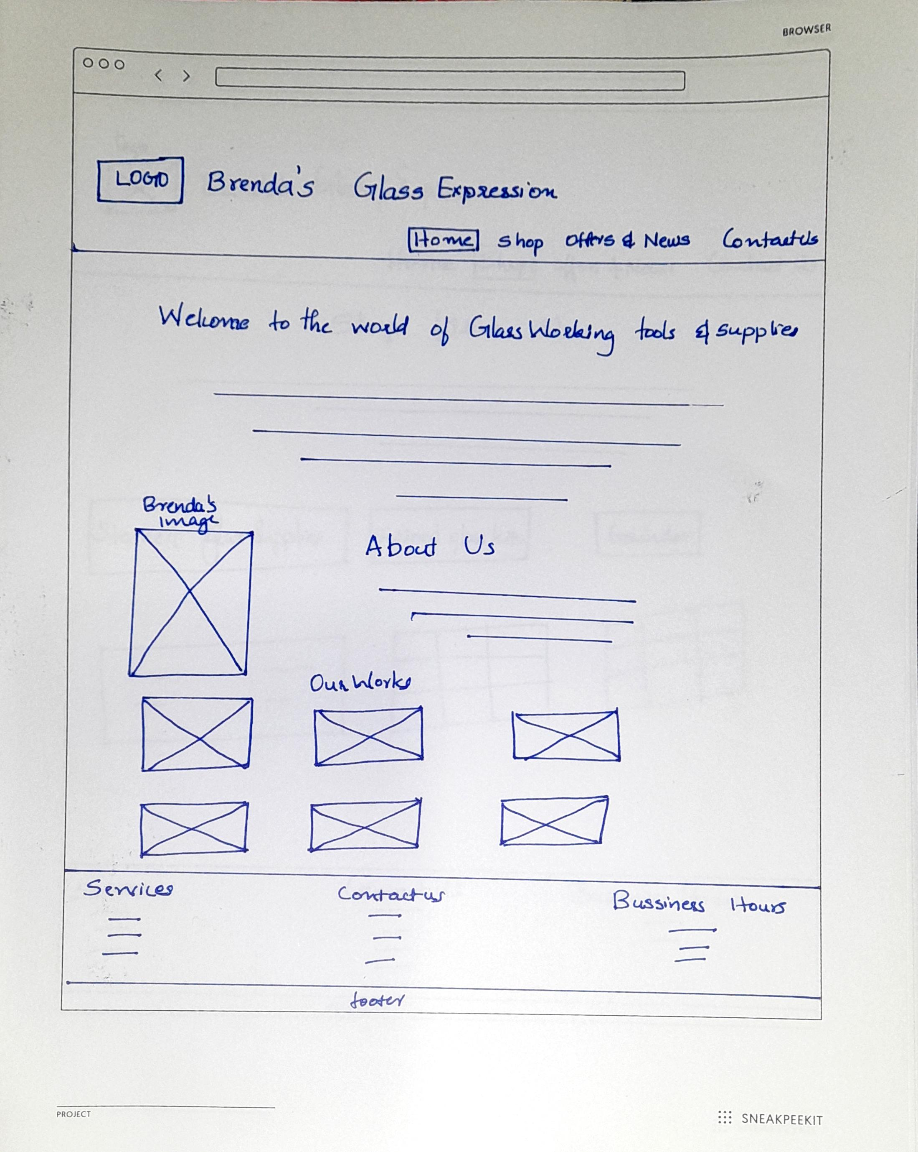
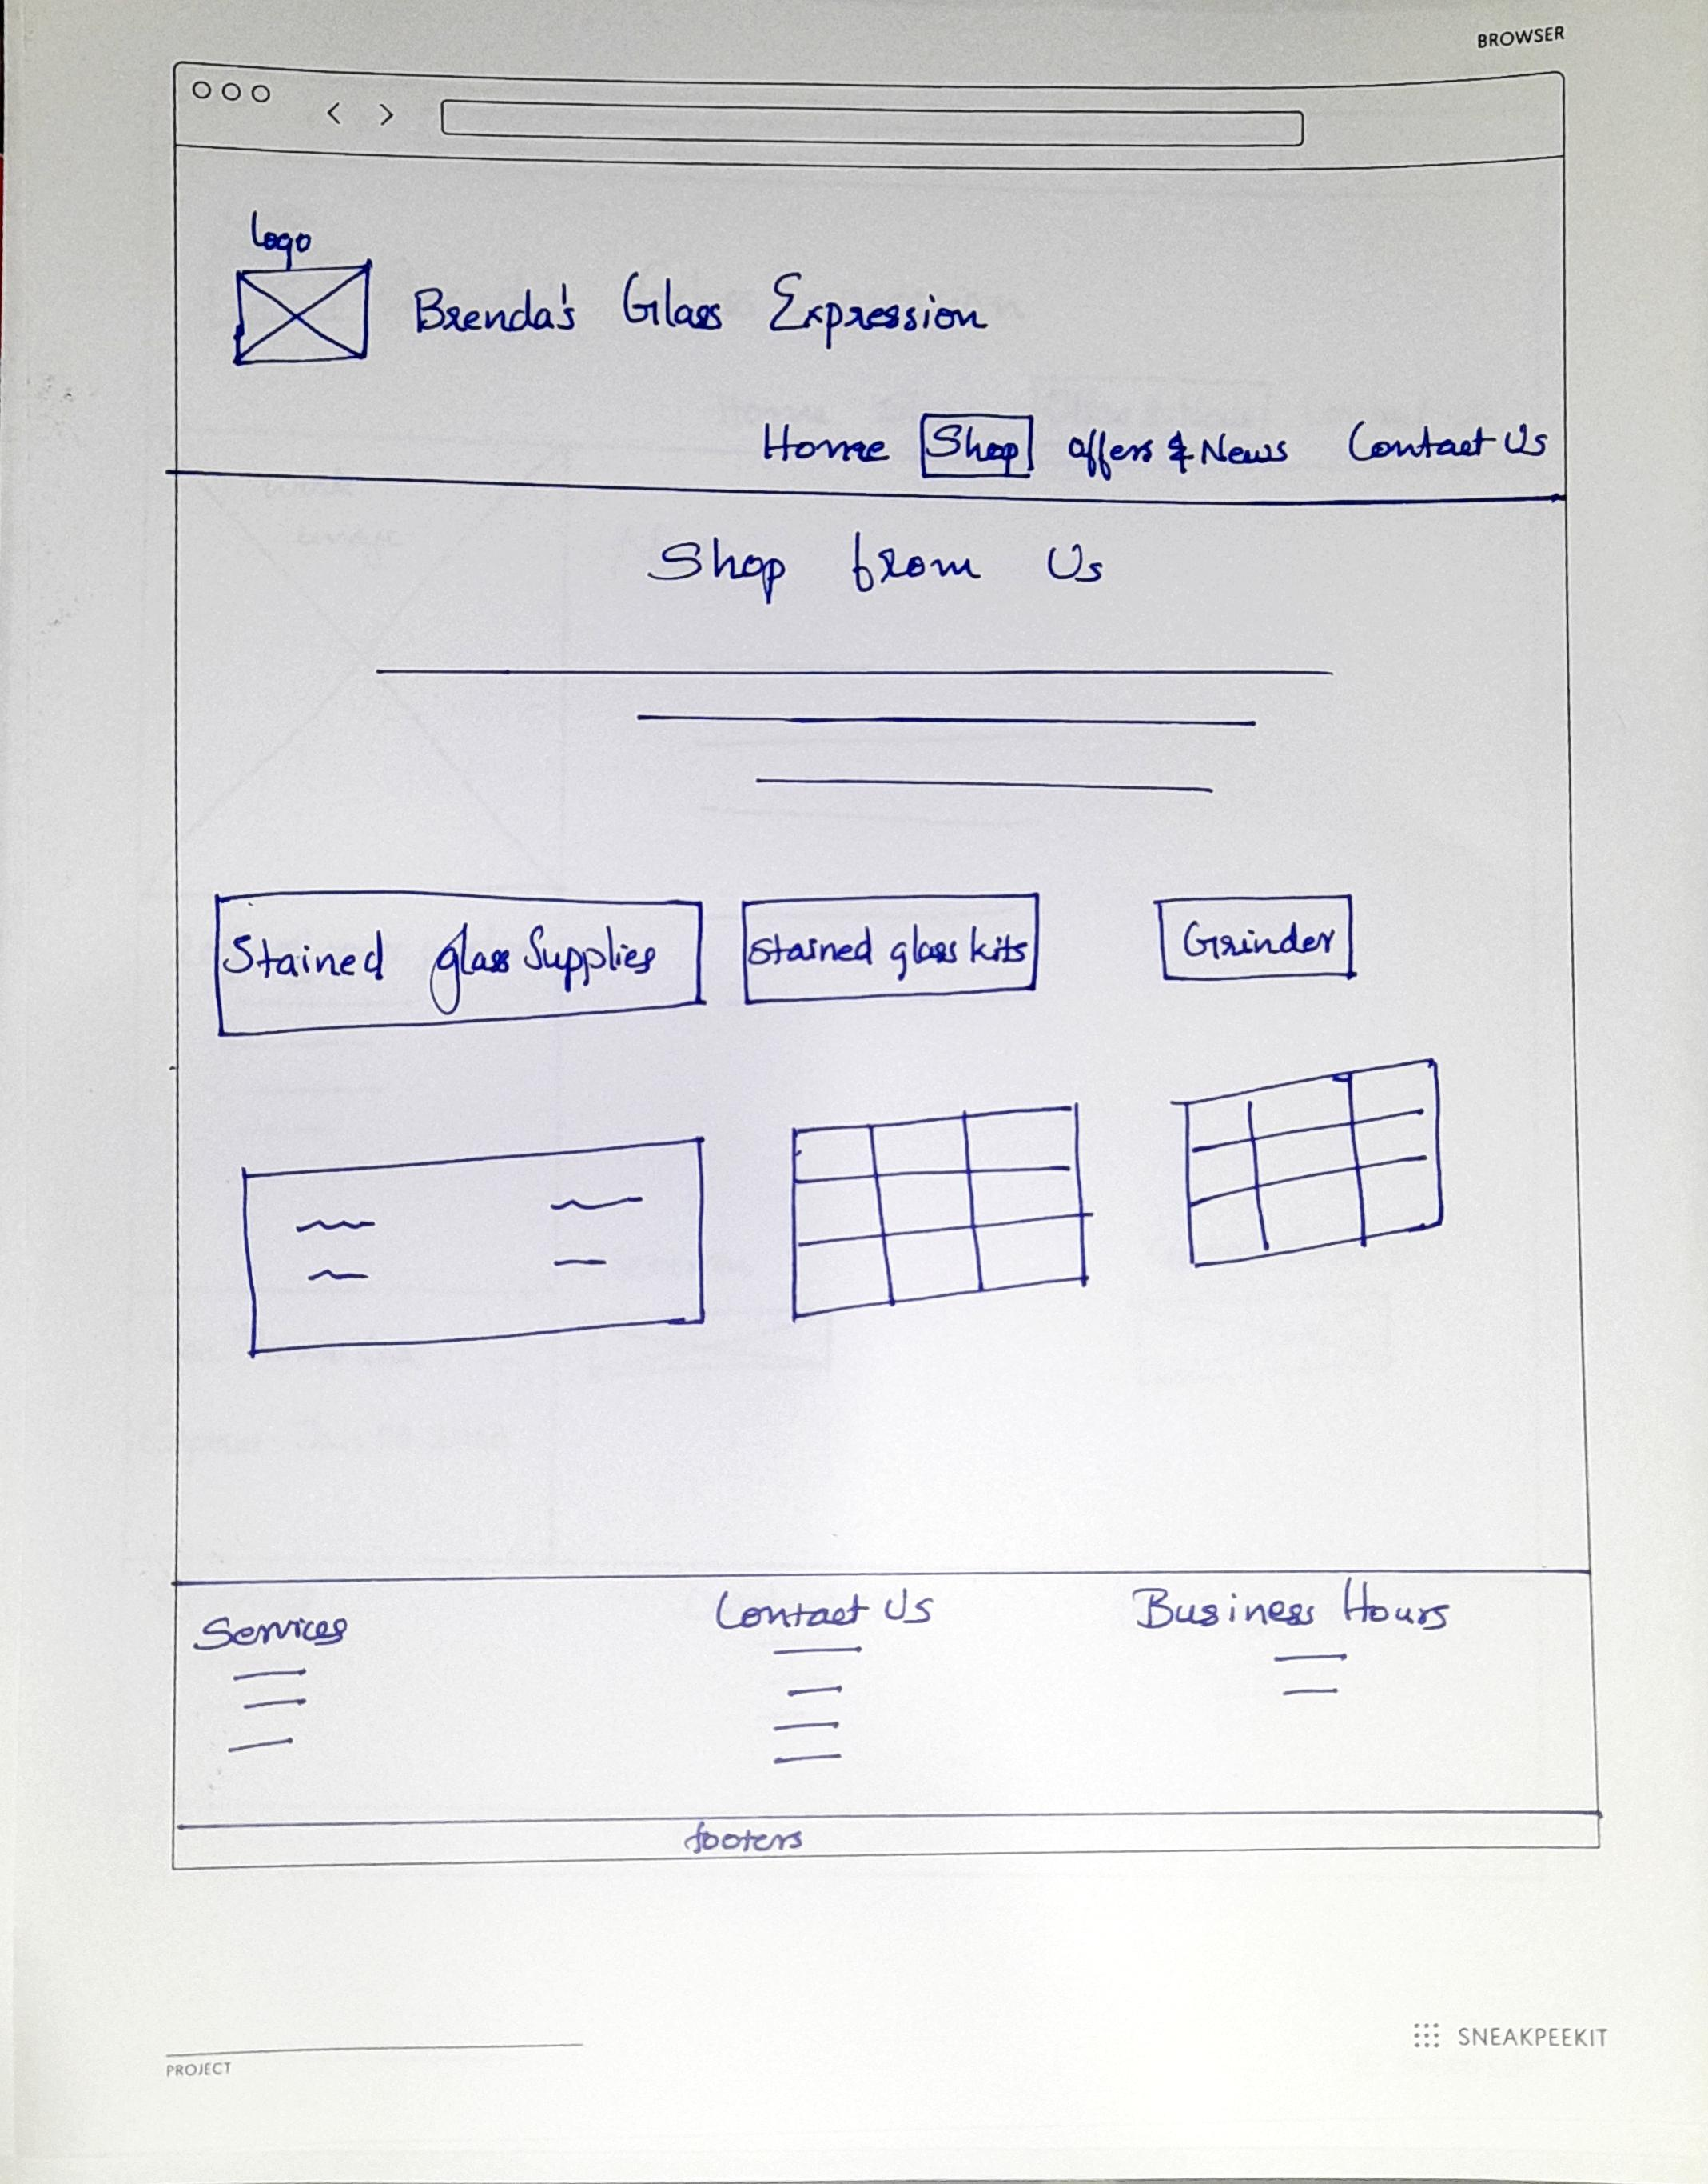
Wireframes
HOME | SHOP

Slide 7
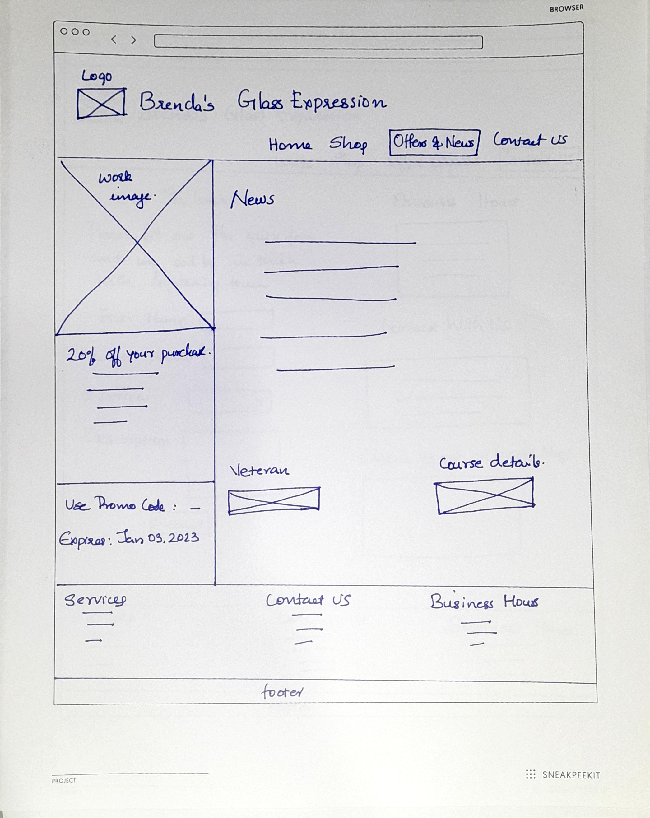
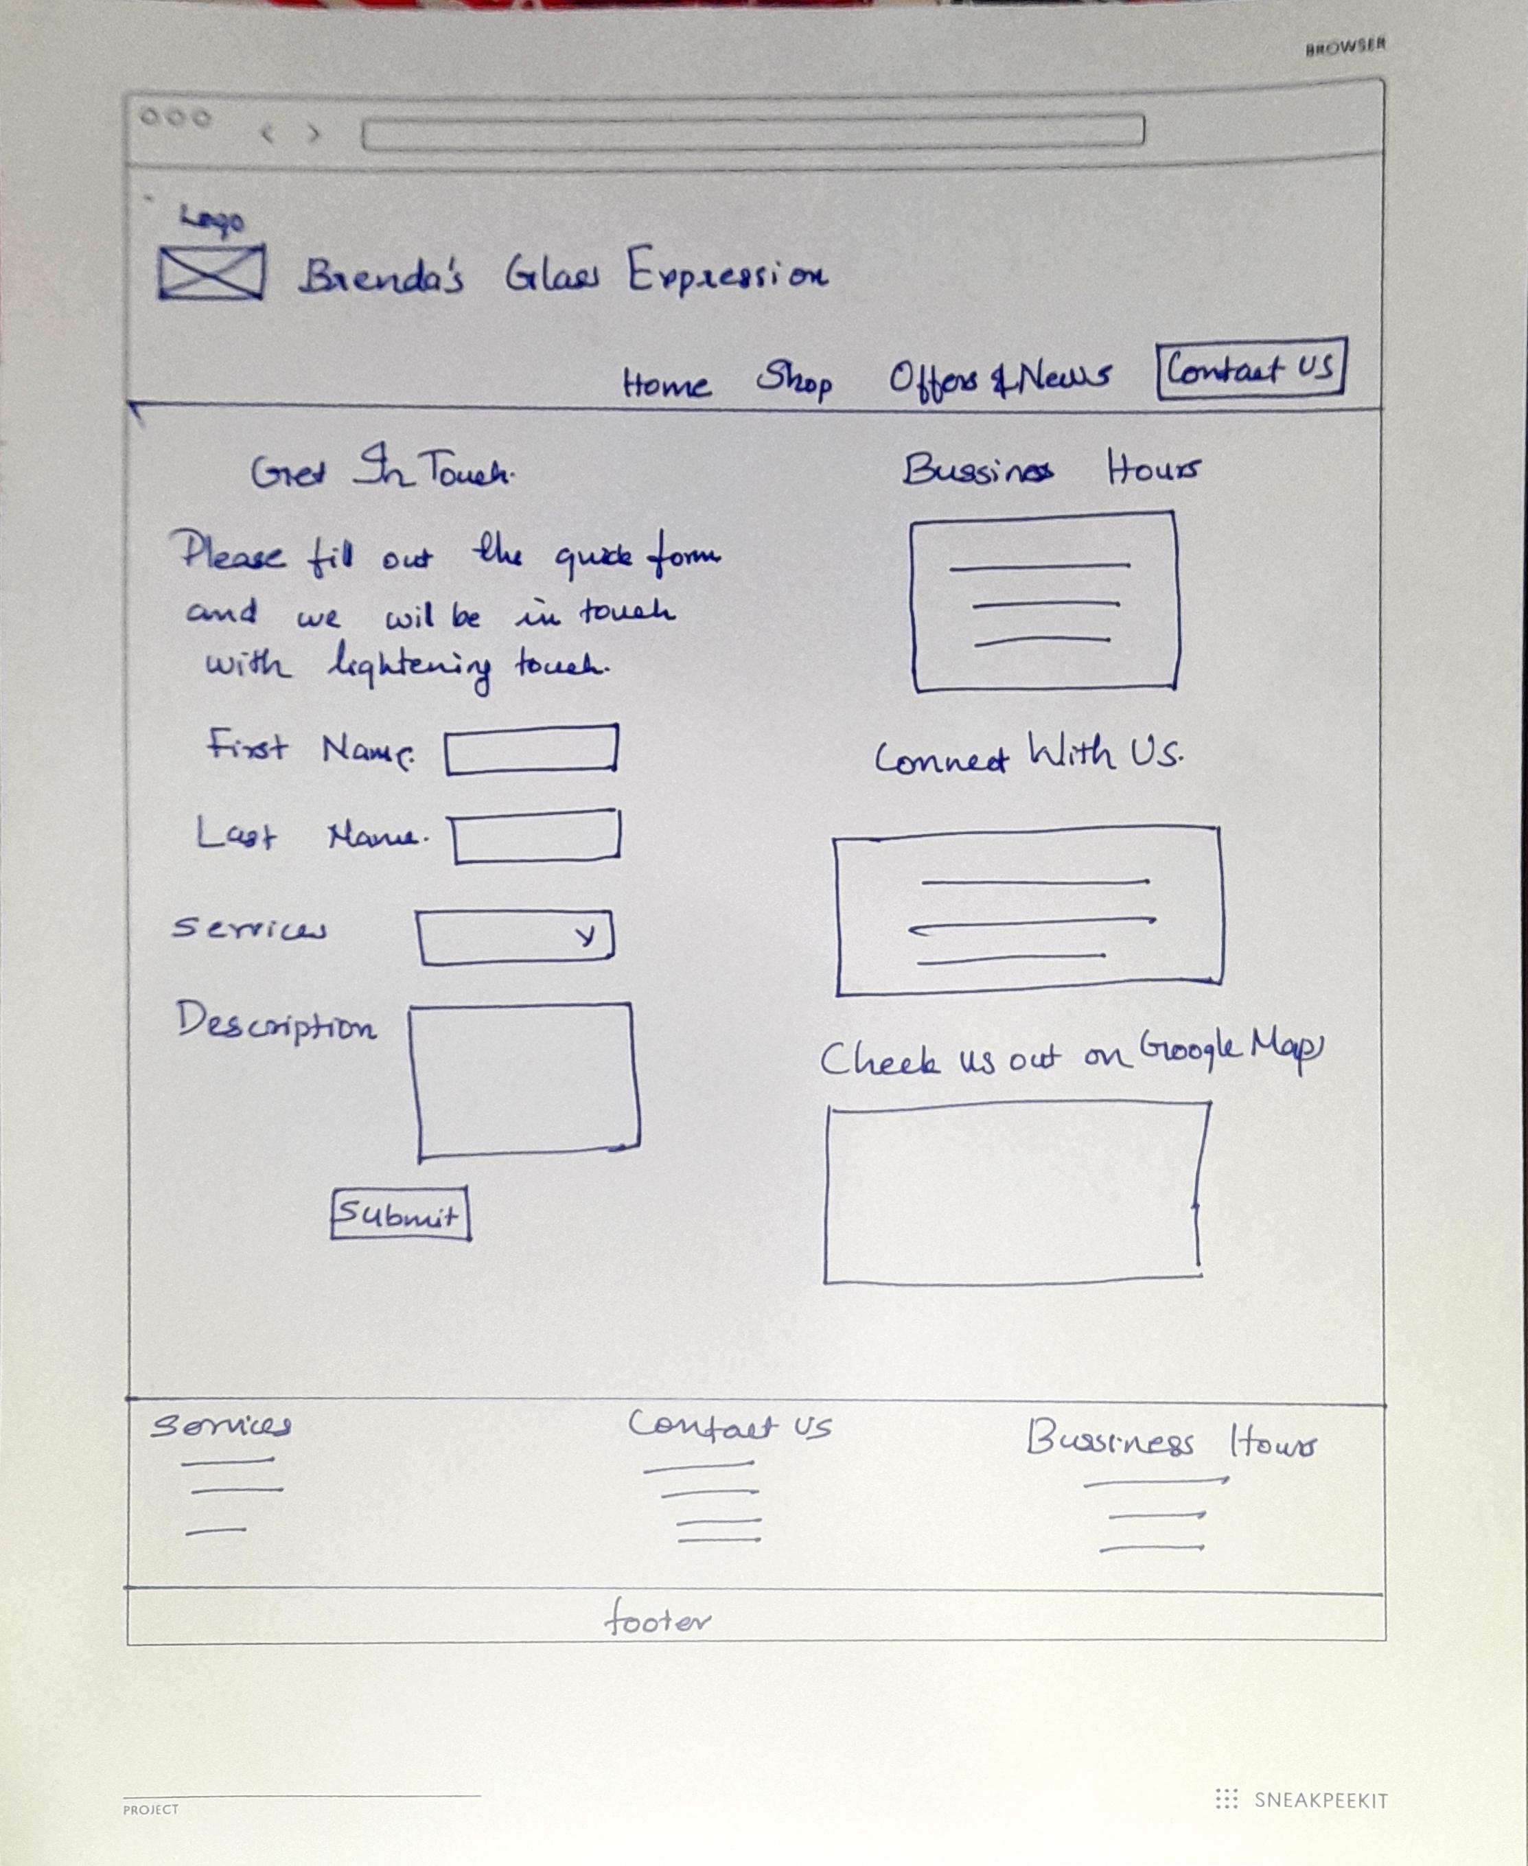
Offers & News | Contact Us

